Slide 1

Beauty is
On the INSIDE
by Adrián, Astrid, Dung & Karoline

Slide 2
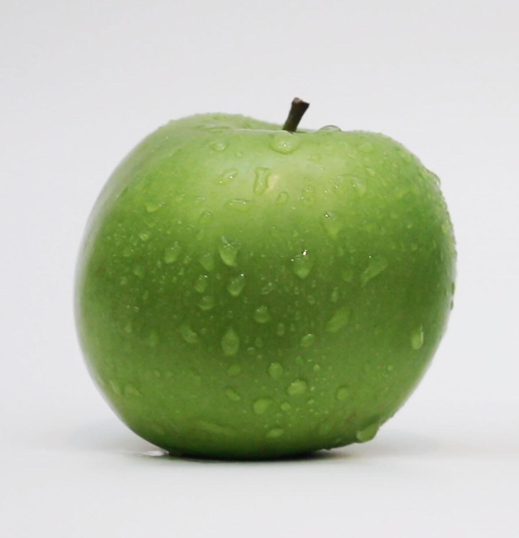
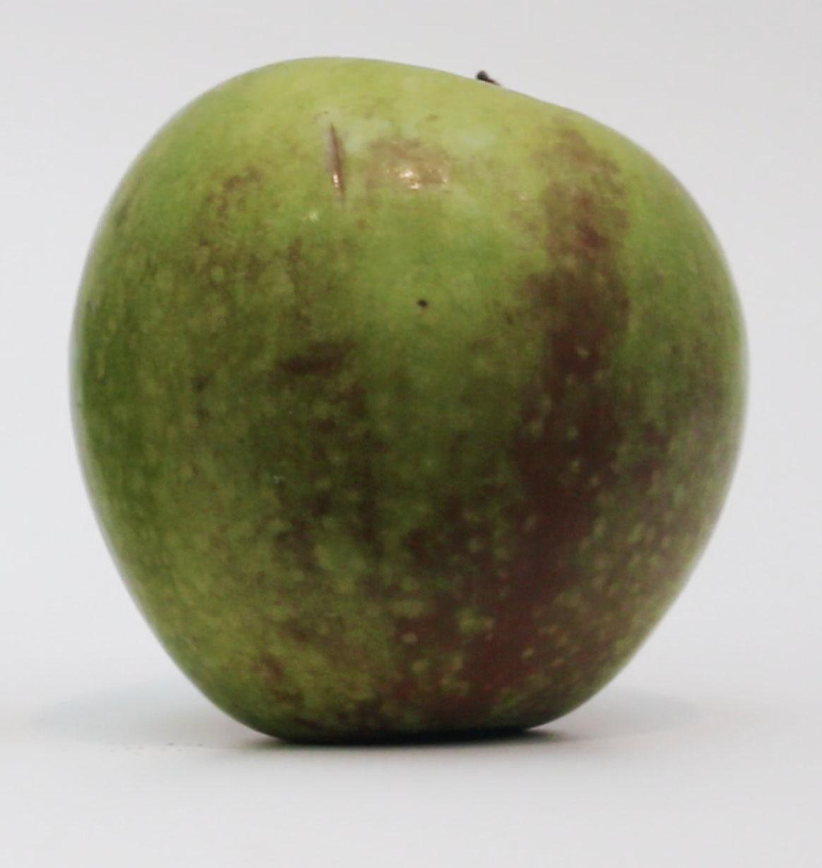
Why?
Help the environment
Reduce food waste
Create awareness about aesthetic standards and Greenhouse gas emission

Slide 3
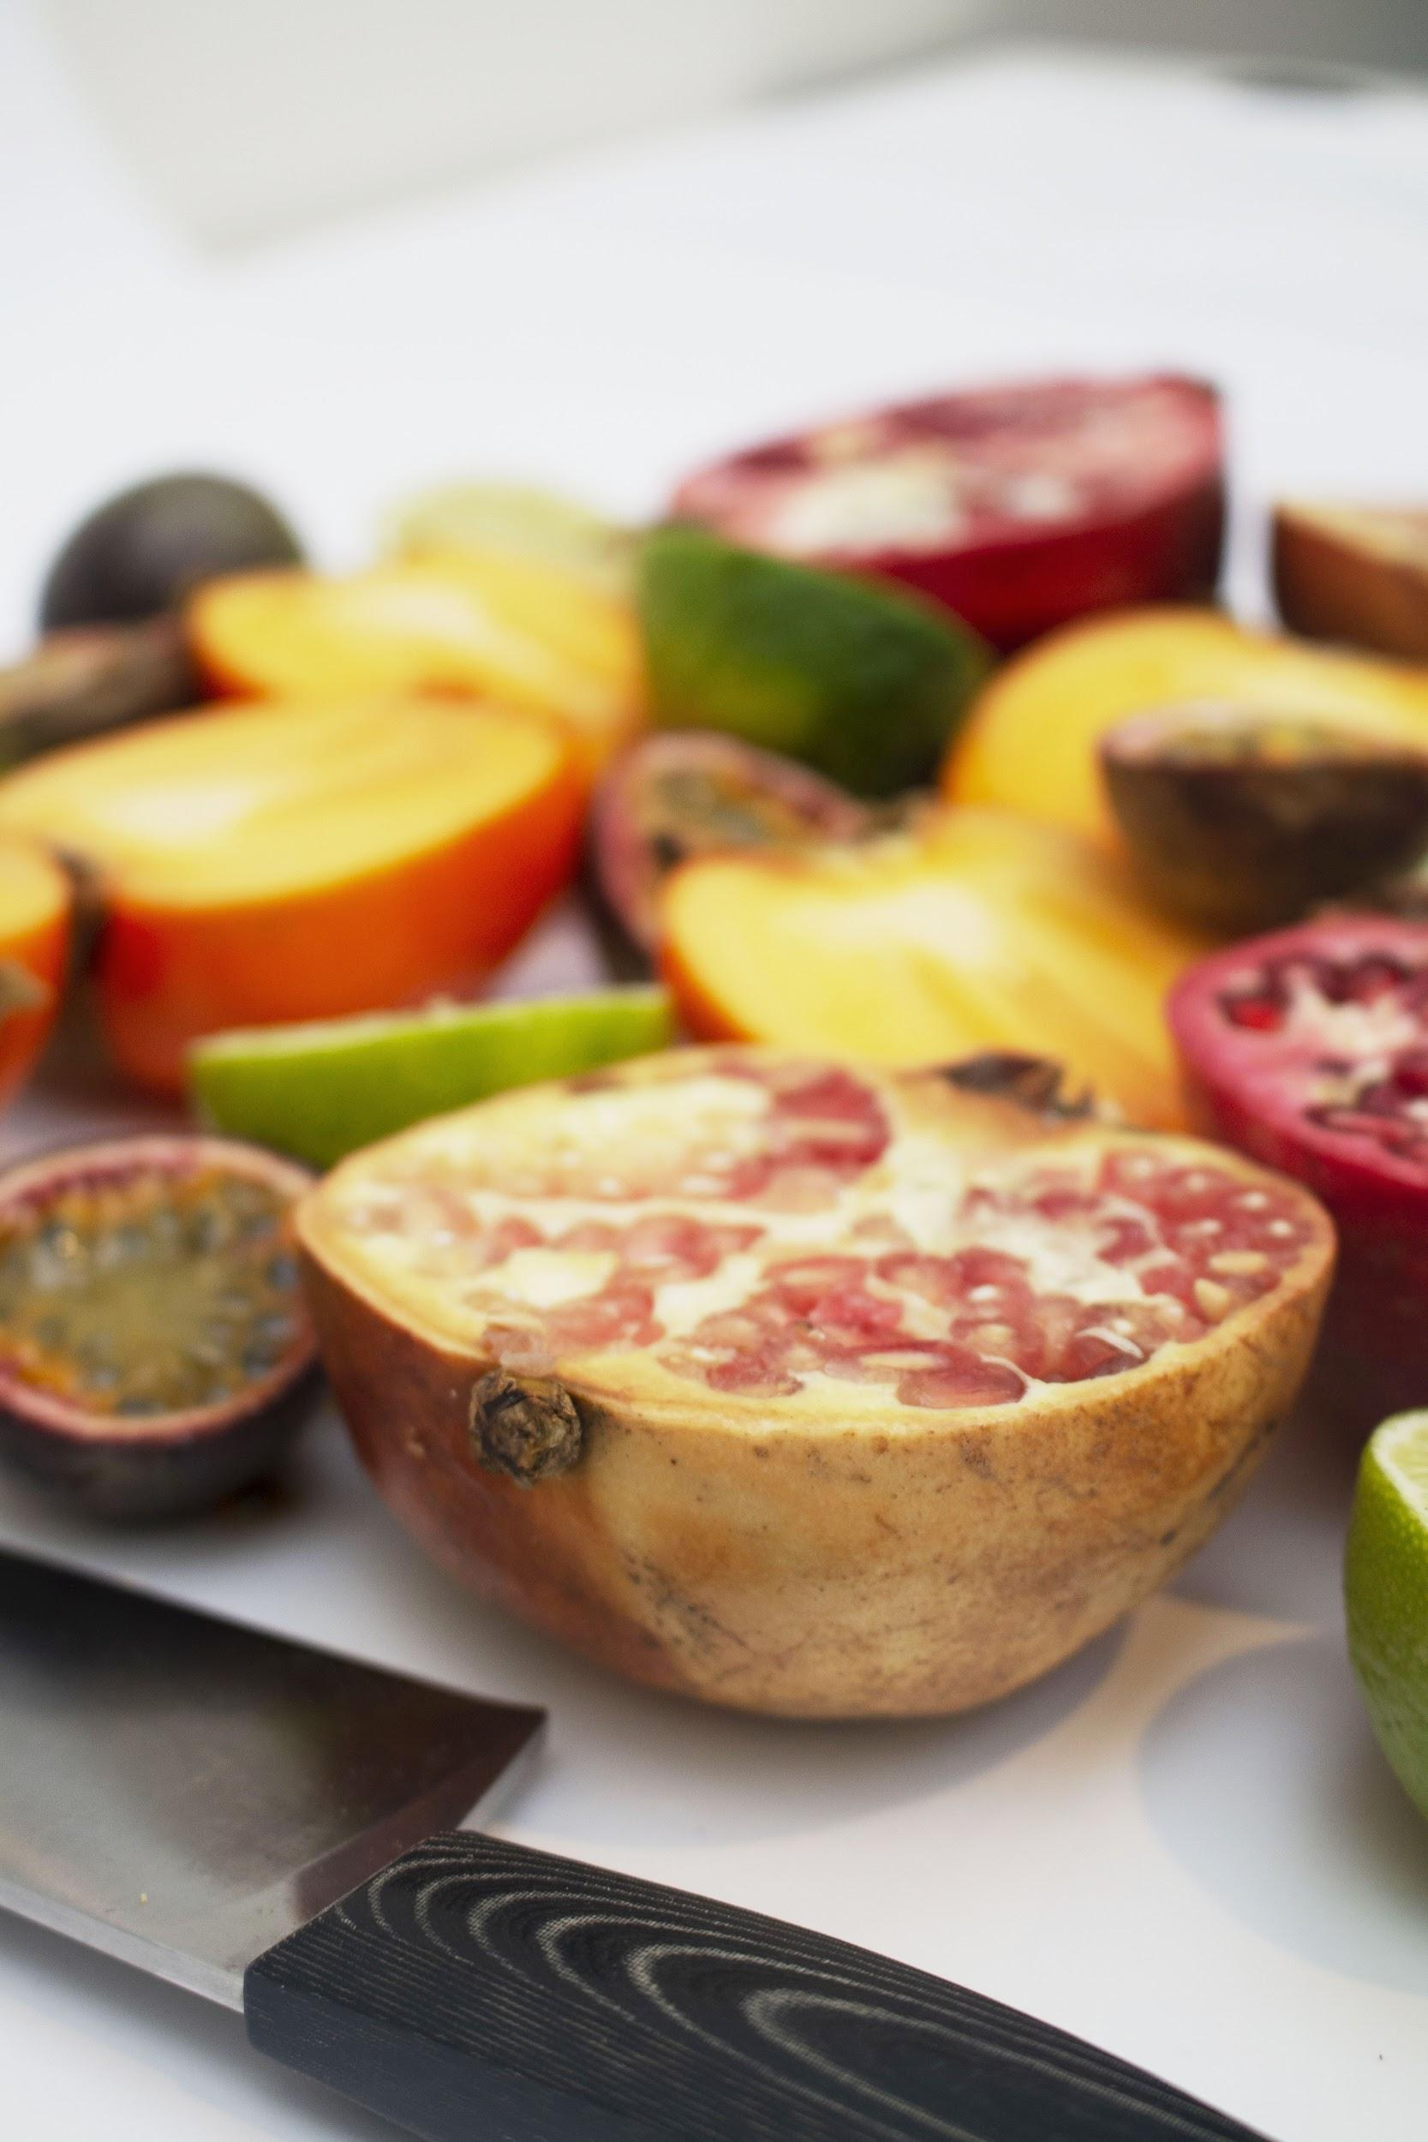

How?
Provoking the viewer
inspirational
How can i help?
Ugly vs. Beauty
Nutrition over looks

Slide 4
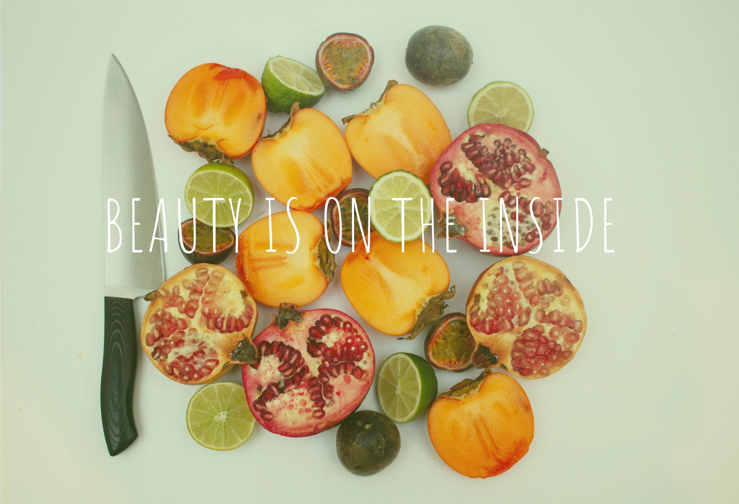
WHAT?
Campaign site
“Beauty is on the inside”
5 small videos
1 longer video
Educational and inspiring text

Slide 5
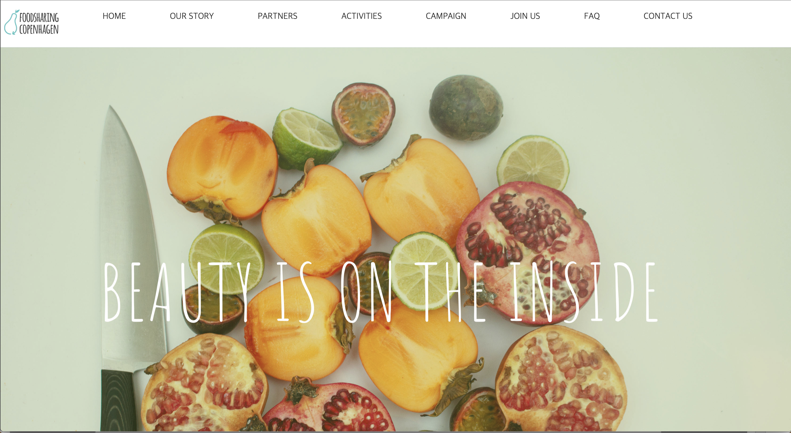
THE CAMPAIGN SITE
http://astridcaecilie.dk/foodsharingcph/

Slide 6
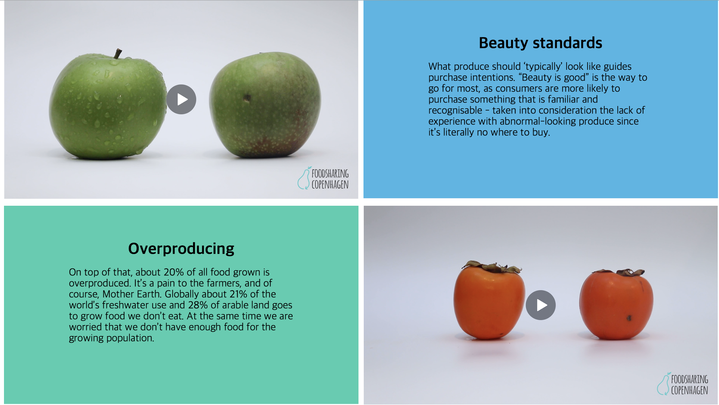
The design
Foodsharing Copenhagen guidelines
Colorscheme
Fonts
Logos

Slide 7
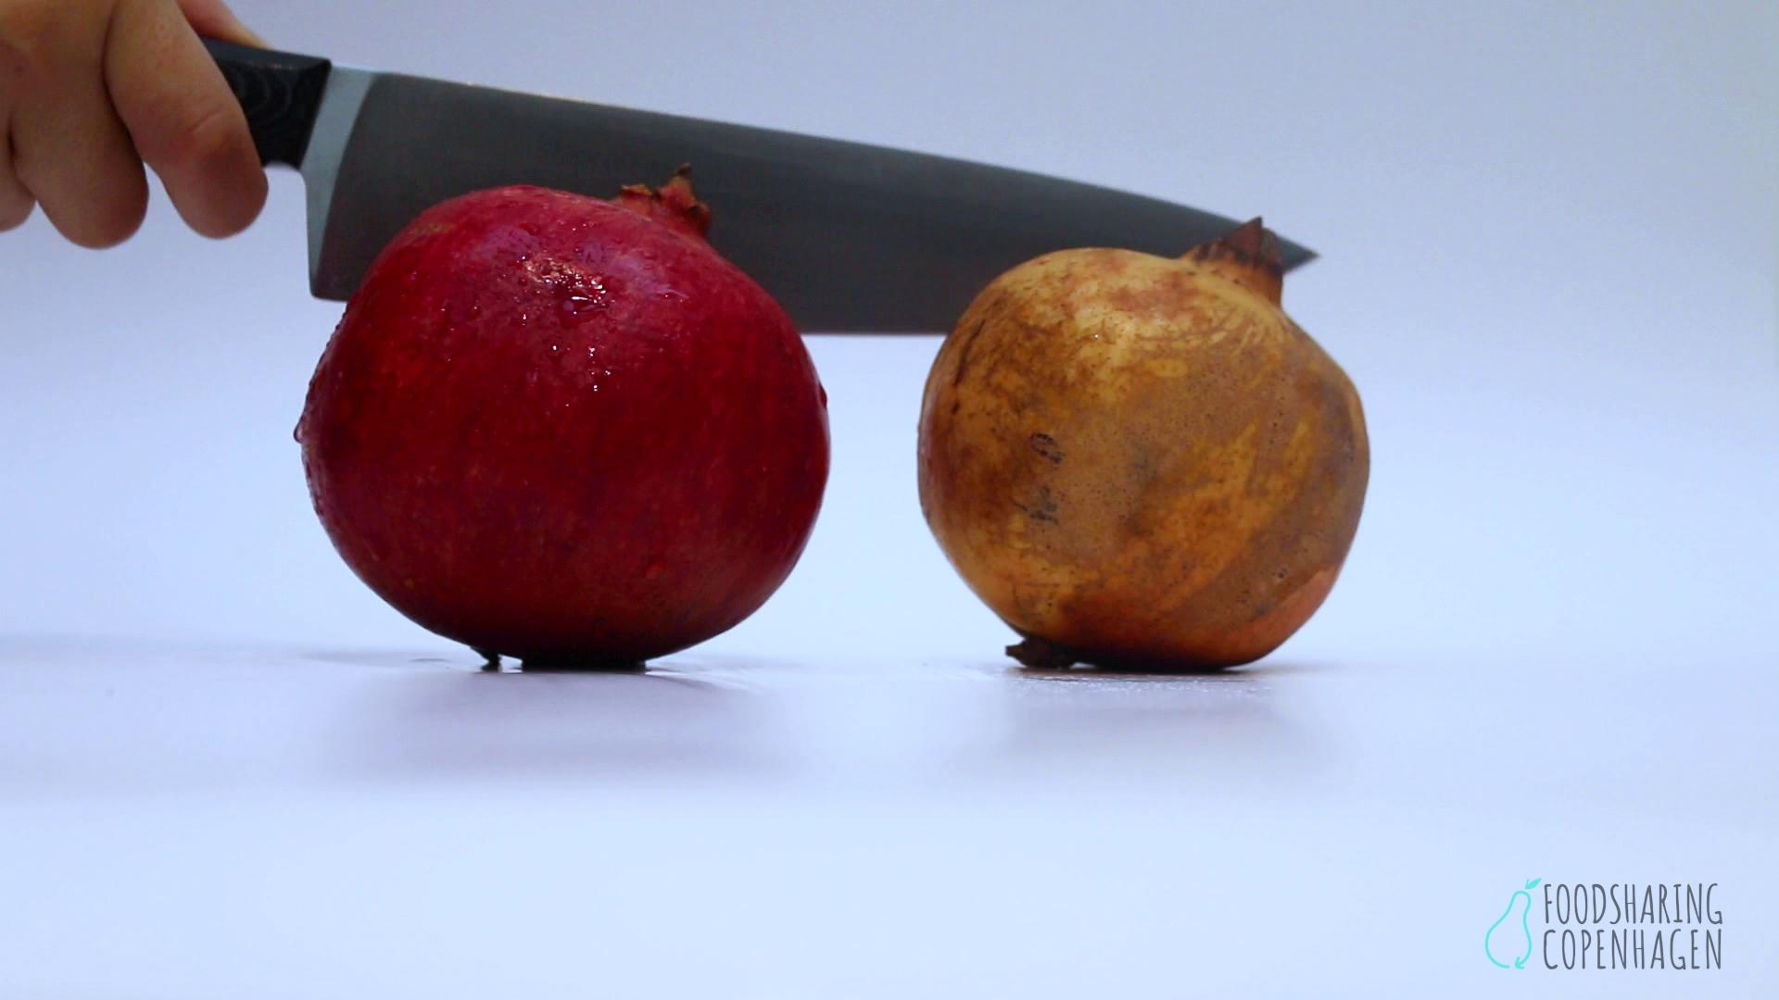
The Video

Slide 8
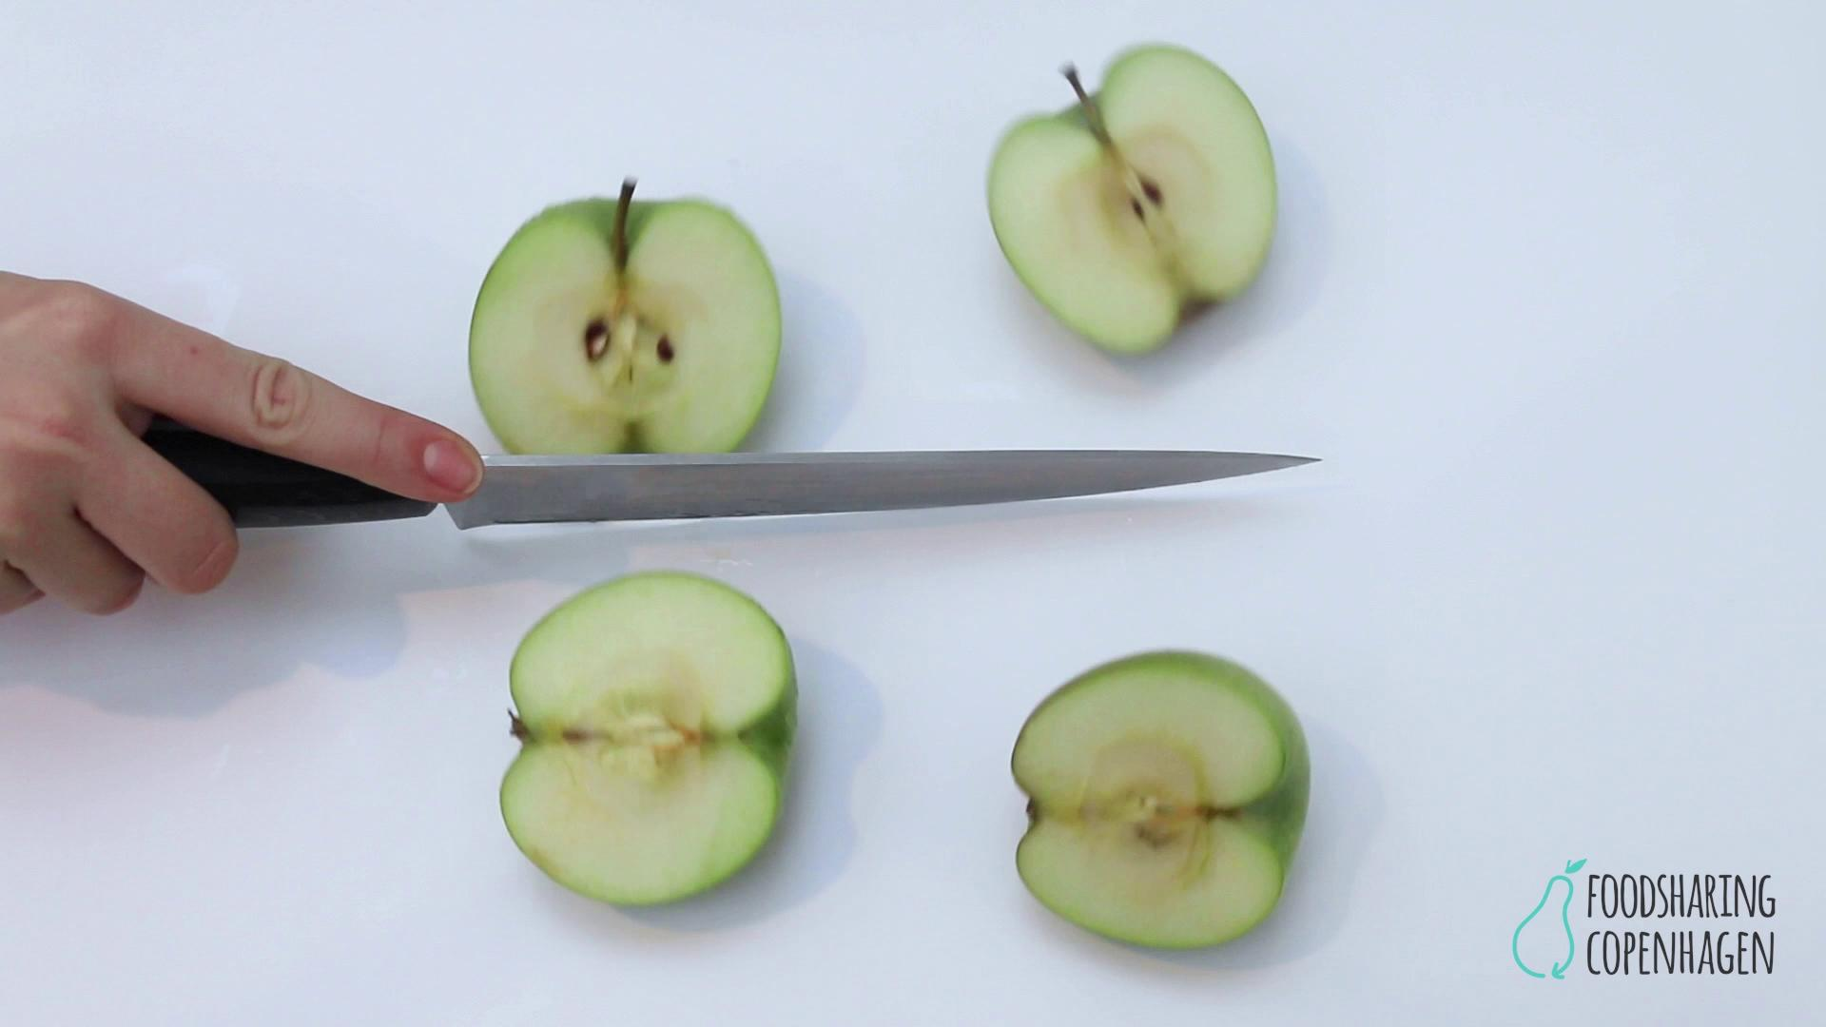
The short videos

Slide 9
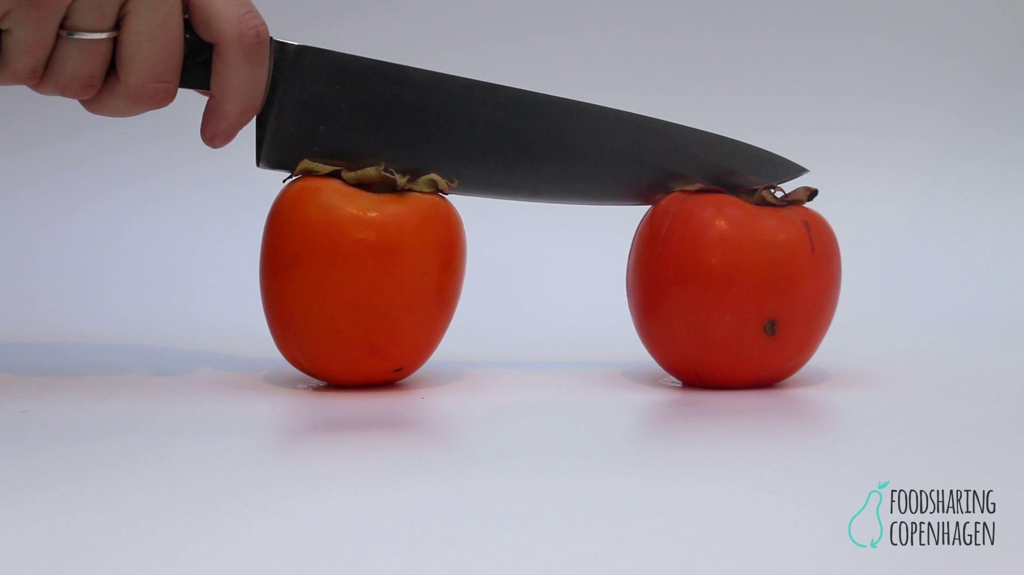
The short videos

Slide 10
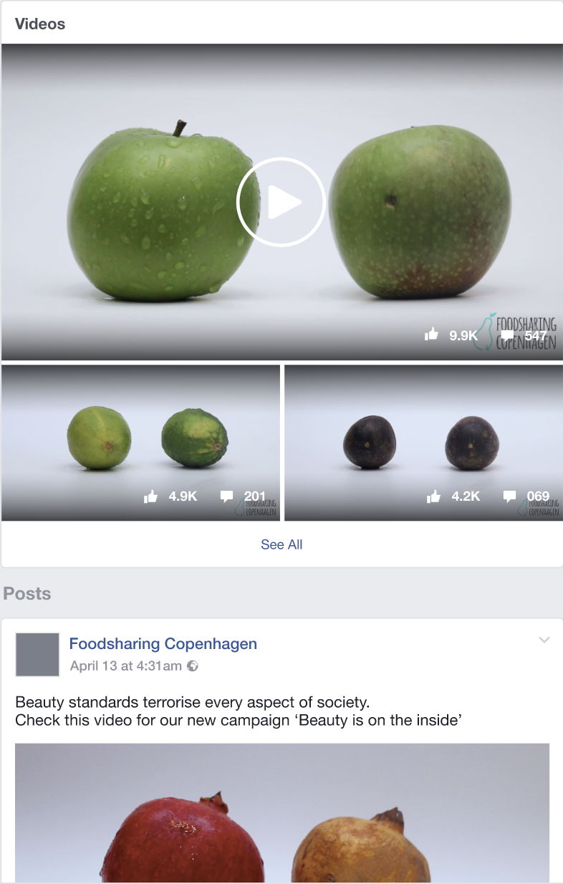
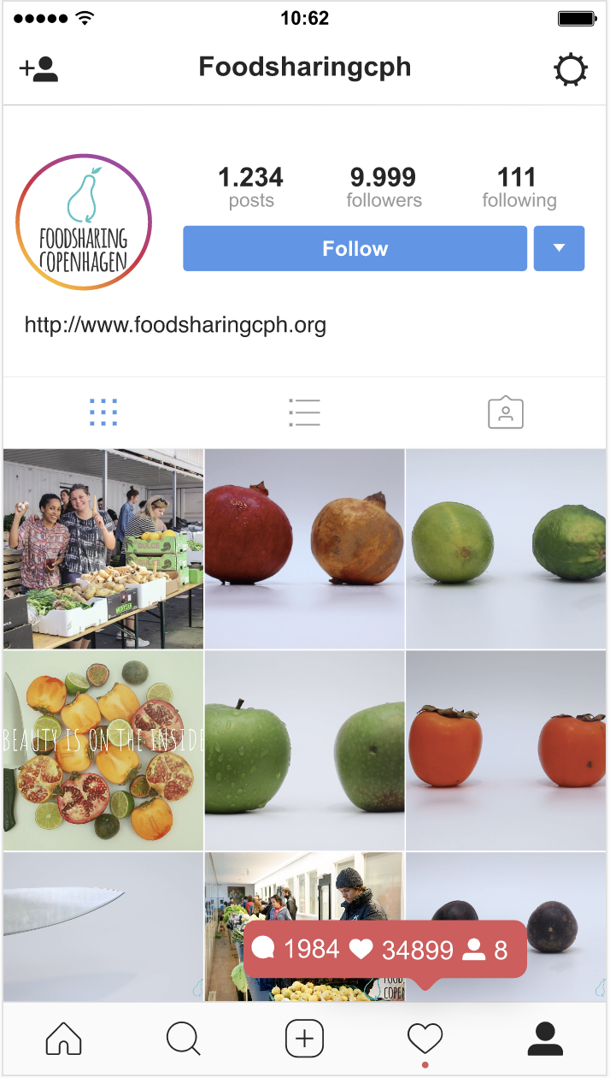


For Social Media
Short videos
Educational short Microcopy
Notes:
Instagram
https://xd.adobe.com/view/6487c9ed-d0a1-4842-7e08-f95b7cc9dd41-12b6/
Facebook
https://xd.adobe.com/view/d551d6b8-bbb2-4871-7dfe-fb38e1a8e3fa-a360/

Slide 11
Thank you for your time
Any questions or feedback?

